Slide 1
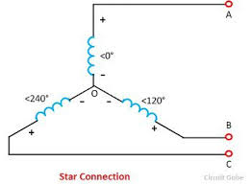
Star Connection
In Star Connection, the 3 phase wires are connected to a common point or star point and Neutral is taken from this common point. The star connection is also called as Y connection.

Slide 2
E_{NR} = E_{NY}=E_{NB}=E_{ph}
There are two phases between two lines. Taking loop NRYN
E_{NR}+E_{RY}-E_{NY}=0
E_{RY} = E_{NY}= E_{NR}
Using vector diagram
E_{RY}=( E_{NY}²+E_{NR}²+2E_{NY}E_{NR}cos60)^{1/2}
E_{RY}=( E_{ph}²+E_{ph}²+2E_{ph}E_{ph}cos60)^{1/2}
E_{RY}=(3)^{1/2} E_{ph}

Slide 3
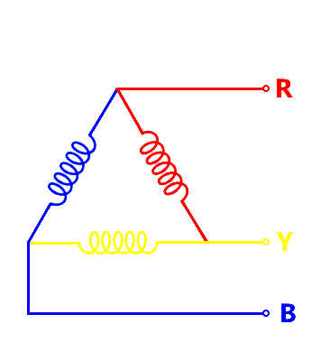
Delta Connection
In a Delta Connection, there are only 3 wires for distribution and all the 3 wires are phases (no neutral in a Delta connection). The following image shows a typical Delta Connection.

Slide 4
Let Voltages be V_{RY}, V_{YB} and V_{BR}
And be V_{RY}=V_{YB} = V_{BR} = V_{L} ,the line voltage
Phase difference is 120 between
V_{RY} & V_{YB}
V_{YB} & V_{BR}
Now currents in first line I₁ =I_{R}-I_{B}
Now currents in second line I₂=I_{Y}-I_{R}
Now currents in third line I₃=I_{B}-I_{Y}
If I_{R}=I_{Y} = I_{B} = I_{ph}
Is phase current then
I₁ =I_{L} = 2 I_{ph} x cos(30)
I₁ =I_{L} = 2 I_{ph} x( 3)^{1/2}/2 =( 3)^{1/2} I_{ph}

Slide 5
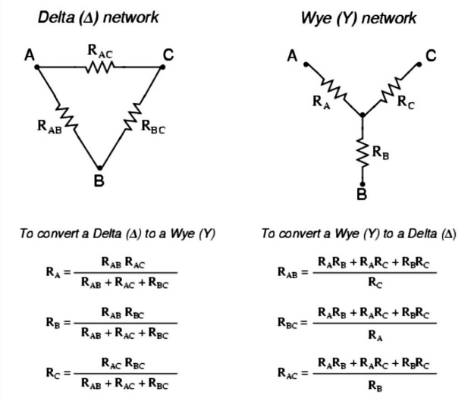
To convertion between star and delta connections

Slide 6
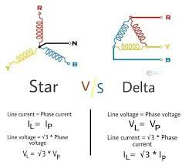

Slide 7
